Slide 1

METHODOLOGICAL STUDY OF COMPUTATIONAL APPROACHES TO STRONG CORRELATIONS.
Juho Lee
Dissertation Defense
Supervisor: Prof. Kristjan Haule
December 6, 2016

Slide 2
Outline
Introduction
Functional approach to many body problem
DMFT for strongly correlated system
H₂ molecule as a testbed for methodological studies
H₂ molecule overview
Exact double-counting of LDA+DMFT
Issues in GW+DMFT implementation
Result
Total energy
Spectral function
Causality violation of GW+DMFT
Causal double-counting for GW+DMFT
Conclusion

Slide 3
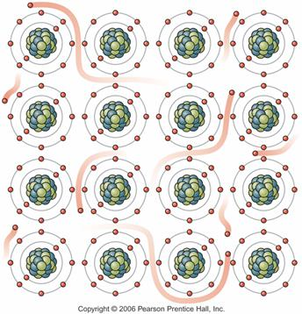
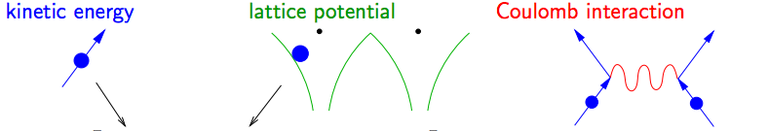
How to solve many-body problem?
Many-body problems
Underlying physics is known: Many-body Schrodinger equation
So, why don’t we just solve it? → IMPOSSIBLE: too many degrees of freedom in solids ~10²³
Dirac’s Quote (1929)
The underlying physical laws necessary for the mathematical theory of a large part of physics and the whole of chemistry are thus completely known, and the difficulty is only that the exact application of these laws leads to equations much too complicated to be soluble. It therefore becomes desirable that approximate practical methods of applying quantum mechanics should be developed, which can lead to an explanation of the main features of complex atomic systems without too much computation.
Proc. Roy. Soc. (London) A 123, 714

Slide 4
Functional Approach
Green’s function: Building block of the manybody problem
(r’, 0)
(r, t)
Baym-Kadanoff formalism gives the grand potential of the system
G. Baym, L.P. Kadanoff Phys. Rev. 124, 287 (1961)
Luttinger-Ward functional: All 2PI skeleton diagrams
Dressed Green’s ftn
v: Coulomb
interaction
Exact solution extremizes the grand potential

Slide 5
Approximation on the LW functional
Solid state physics is all about reasonable approximation
Exact LW
i
i
i
i
i
i
i
i
i
i
(i=local site)
i
i
i
i

Slide 6
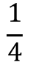
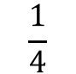
$$\frac{1}{2}$$
$$\frac{1}{2}$$
$$\frac{1}{4}$$
$$\frac{1}{4}$$

Slide 7
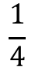
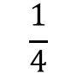
$$\frac{1}{2}$$
i
i
$$\frac{1}{2}$$
i
i
i
i
i
$$\frac{1}{4}$$
$$\frac{1}{4}$$
i
i
i
i
i

Slide 8
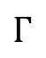
a)
b)
F
$$Γ$$
F⁰
F⁰
G⁰
G
G⁰
G

Slide 9
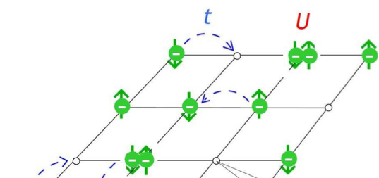
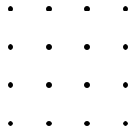
Strongly Correlated system
Hubbard model (1963)
Electron hopping
On-site interaction
U / t ~ 0
U / t ~ O(1)
U / t >>1
Itinerant
Strongly Correlated Materials
Localized
Metal-insulator transition
High Tc superconductivity
Heavy fermions.
Independent particle approaches work well
Cost for double occupation is too large.
Electrons are localized.

Slide 10
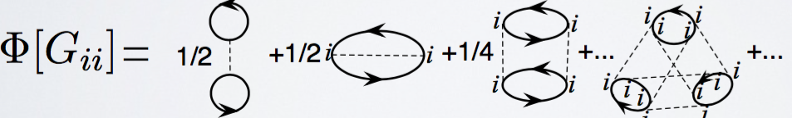
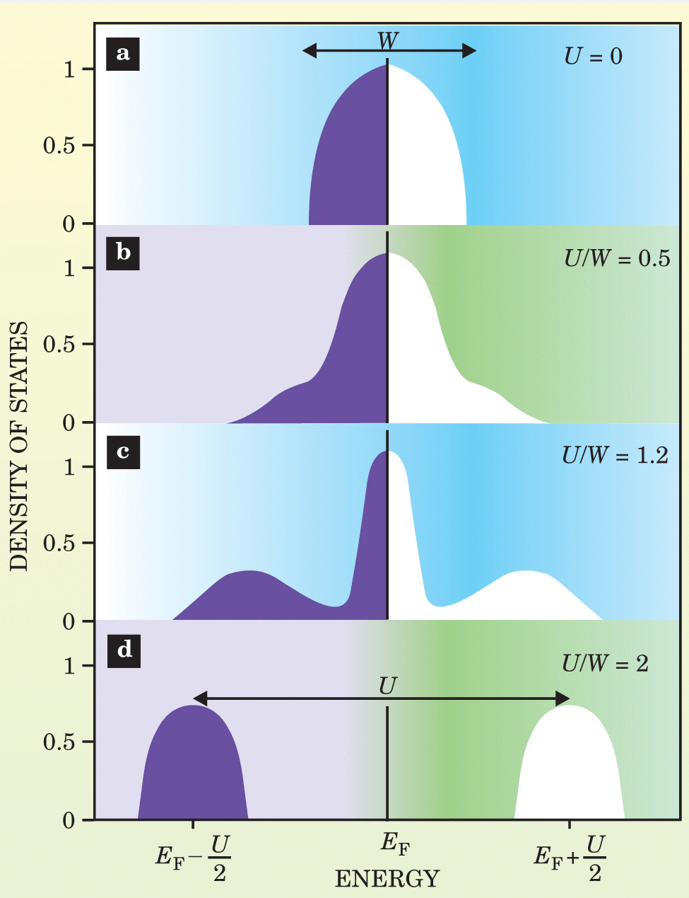
Dynamical Mean-Field Theory
Dynamical mean-field theory (DMFT)
: All local irreducible diagrams (i = atomic site)
Metal-insulator transition
U / W ~ 0
A. George, G. Kotliar Phys. Rev. B 45, 6479 (1992)
DMFT applied in Hubbard model
U / W>>1
Assumption: spatial quantum fluctuations are frozen
Local self-energy contains all irreducible skeleton diagrams
One of standard methods for strong correlations

Slide 11
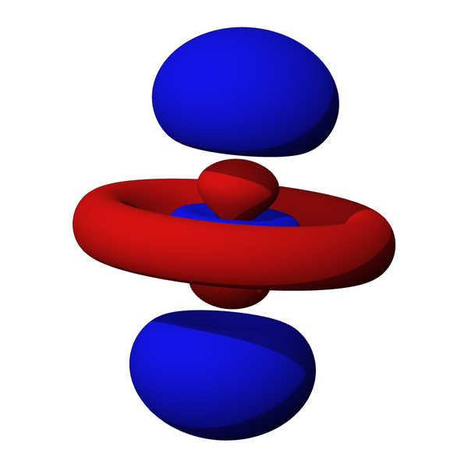
Combined band structure methods and DMFT
Dynamical Mean-Field Theory (DMFT)
Treats strong correlations
Too expensive to deal with the entire degrees of freedom
Density functional theory (Local density approximation: LDA)
Efficient for total energy calculation in real materials
GW approximation
Excellent for band-gap calculation of weakly or moderate correlated systems

Slide 12
Combined band structure methods and DMFT
LDA/GW + DMFT
Correlated electrons in d- or f- orbitals properly treated by DMFT.
s- and p- orbitals are computed by LDA or GW.
Huge number of applications to real materials

Slide 13
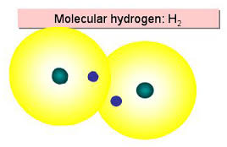
DMFT on quantum chemistry
Is it also a good approximation for molecules?
In quantum chemistry society, it is well-known that the exchange effect is non-local while the correlations have a short-range nature in molecules → DMFT should work!
N. Lin et al. (Phys. Rev. Lett. 106, 096402) : Hartree-Fock + cDMFT application to the H_{n} cluster calculation
H₂ molecule as a test bed for methodological study based on DMFT
GW+DMFT issues
J. Lee, K. Haule, arXiv:1611.07090
Double-counting problem of LDA+DMFT J. Lee, K. Haule Phys. Rev. B 91, 155144 (2015)

Slide 14
H₂ molecule as a test bed
t
Why is H₂ good for methodological study?
H₂ molecule is a strongly correlated system (approximately 2-site Hubbard model)
Well known exact solution exists (full CI calculation)
No ambiguity for the effective local interaction U (Parameter free)
Small system, easy to implement and test.
U/t < 1
U/t >> 1

Slide 15
Double-counting issue of LDA+DMFT
J. Lee, K. Haule Phys. Rev. B 91, 155144 (2015)
LDA
DMFT
The double-counting problem of LDA+DMFT has been a long time issue in the community
Why is it difficulty to solve?
DMFT is a diagrammatic many-body approach
However, the exchange-correlation functional of LDA is obtained by mapping the local point to a uniform electron gas. Non-diagrammatic, highly non-linear, and not decoupled orbital-wise.
Can we find the exact intersection? YES!
Double counting
: the part considered twice by the two methodologies

Slide 16
Double-counting of correlations
From the view point of functional approach, we can calculate the exact double-counting of LDA+DMFT.
LDA approximation Density of each point → uniform electron gas
DMFT approximation
Exact LW functional
(for H₂ no screened interaction)
Intersection of both approximations:
Electron gas problem with projected density
DC of LDA correlation
Total Double Counting:
J. Lee, K. Haule Phys. Rev. B 91, 155144 (2015)
This idea was extended to solid-state calculation: K. Haule, Phys. Rev. Lett. 115, 196403 (2015)

Slide 17
Issues of GW+DMFT
GW+DMFT
Different schemes: level of self-consistency / type of GW / double-counting
Subtraction of frequency dependent double-counting: Causality issue?
J. Lee, K. Haule, arXiv:1611.07090 (submitted to PRB)
 | Moderate correlation | Strong correlation
Self-consistent GW+DMFT | Work(excellent) | N.A.
Self-consistent GW+DMFT with causal DC | Working (Fair) | Working
G₀W₀^{(HF)}+DMFT | Work(excellent) | N.A.
G₀W₀^{(HF)}+DMFT (no SC) |  | N.A.
G₀W₀^{(LDA)}+DMFT | Working (Fair) | N.A.
G₀W₀^{(LDA)}+DMFT (no SC) |  | N.A.
QSGW+DMFT (static DC) | Working (Fair) | Working
QSGW+DMFT (dynamical DC) | Spectral is excellent | Working (bad)

Slide 18
Issues of GW+DMFT
GW+DMFT
Different schemes: level of self-consistency / type of GW / double-counting
Subtraction of frequency dependent double-counting: Causality issue
J. Lee, K. Haule, arXiv:1611.07090 (submitted to PRB)
 | Moderate correlation | Strong correlation
Self-consistent GW+DMFT | Work(excellent) | N.A.
Self-consistent GW+DMFT with causal DC | Working (Fair) | Working
G₀W₀^{(HF)}+DMFT | Work(excellent) | N.A.
G₀W₀^{(HF)}+DMFT (no SC) |  | N.A.
G₀W₀^{(LDA)}+DMFT | Working (Fair) | N.A.
G₀W₀^{(LDA)}+DMFT (no SC) |  | N.A.
QSGW+DMFT (static DC) | Working (Fair) | Working
QSGW+DMFT (dynamical DC) | Spectral is excellent | Working (bad)

Slide 19
Basis set and DMFT local orbital
Basis set: eigenfunctions of H₂⁺ problem (>30 orbitals)
Energy
anti-bonding state
bonding state
anti-bonding state
DMFT local orbital
bonding state
H(1)
H(2)

Slide 20
LDA / GW + DMFT for H₂ molecule
Higher states
LDA/GW
DMFT
DMFT
Double counting
subtraction
H(1)
H(2)

Slide 21
DMFT calculation in H₂
Projection to local DMFT orbital
H(1)
H(2)
Auxiliary impurity
DMFT: Effective local problem
Hybridization between the impurity and the reservoir
The local interaction U is given by
Local action
Impurity solver (CTQMC) → exact impurity (local) self-energy

Slide 22
Result: Total Energy
HF/LDA/GW
 | R = 1.4 | R = 5.0
Exact | -2.345 | -2.005
HF | -2.249 (~4.2%) | -1.710 (~14%)
LDA | -2.259 (~3.8%) | -1.849 (~7%)
GW | -2.374 (~1.2%) | -1.832 (~7%)
HF
LDA
GW
Exact
Atomic limit -2 Ry : energy of two independent hydrogen atoms
R = 1.4 (Eq. length / moderate correlation)
R ~ 5.0 (atomic limit: strong correlation)
HF: lack of correlation
LDA: exchange-correlation is inaccurate
GW: pretty good approximation
HF/LDA: itinerant solution gives probability of double occupation at each single site.
GW: failure of perturbation theory

Slide 23
Result: Total Energy
HF+DMFT
 | R = 1.4 | R = 5.0
Exact | -2.345 | -2.005
HF | -2.249 (~4.2%) | -1.710 (~14%)
LDA | -2.259 (~3.8%) | -1.849 (~7%)
GW | -2.374 (~1.2%) | -1.832 (~7%)
HF+DMFT | 2.323 (~1%) | -2.02 (~ 1%)
HF
HF+DMFT
Exact
Corrected by DMFT
R = 1.4 (Eq. length / moderate correlation)
R ~ 5.0 (atomic limit: strong correlation)
HF
DMFT
correlation
HF+DMFT
HF+DMFT: Atomic limit is recovered!
(5% error)
(1% error)

Slide 24
Result: Total Energy
LDA+DMFT
 | R = 1.4 | R = 5.0
Exact | -2.345 | -2.005
HF | -2.249 (~ 4.2%) | -1.710 (~14%)
LDA | -2.259 (~ 3.8%) | -1.849 (~7%)
GW | -2.374 (~1.2%) | -1.832 (~7%)
HF+DMFT | -2.323 (~ 1%) | -2.02 (~1%)
LDA+DMFT | -2.342 (~ 0.2%) | -2.02 (~1%)
LDA+DMFT
Corrected by DFT
HF
LDA+DMFT
Exact
Corrected by DMFT
R = 1.4 (Eq. length / moderate correlation)
R ~ 5.0 (atomic limit: strong correlation)
HF+DMFT
LDA
correlation
LDA+DMFT
LDA+DMFT: correct atomic limit
(1% error)
(~0.2% error)

Slide 25
Result: Total Energy
GW+DMFT
 | R = 1.4 | R = 5.0
Exact | -2.345 | -2.005
HF | -2.249 (~ 4.2%) | -1.710 (~14%)
LDA | -2.259 (~ 3.8%) | -1.849 (~7%)
GW | -2.374 (~1.2%) | -1.832 (~7%)
HF+DMFT | -2.323 (~ 1%) | -2.02 (~1%)
LDA+DMFT | -2.342 (~ 0.2%) | -2.02 (~1%)
GW+DMFT | -2.342 (~ 0.2%) | N.A.
LDA+DMFT
Corrected by DMFT
GW
LDA+DMFT
Exact
GW+DMFT
R = 1.4 (Eq. length / moderate correlation)
R ~ 5.0 (atomic limit: strong correlation)
GW+DMFT rivals LDA+DMFT in moderate correlated regime.

Slide 26
Result: Total Energy
GW+DMFT
 | R = 1.4 | R = 5.0
Exact | -2.345 | -2.005
HF | -2.249 (~ 4.2%) | -1.710 (~14%)
LDA | -2.259 (~ 3.8%) | -1.849 (~7%)
GW | -2.374 (~1.2%) | -1.832 (~7%)
HF+DMFT | -2.323 (~ 1%) | -2.02 (~1%)
LDA+DMFT | -2.342 (~ 0.2%) | -2.02 (~1%)
GW+DMFT | -2.342 (~ 0.2%) | N.A.
LDA+DMFT
Corrected by DMFT
GW
LDA+DMFT
Exact
GW+DMFT
R = 1.4 (Eq. length / moderate correlation)
R ~ 5.0 (atomic limit: strong correlation)
Causality violation for R>3.5
GW+DMFT rivals LDA+DMFT in moderate correlated regime.

Slide 27
Spectral function at R=1.4
LDA+DMFT
Vacuum
7%
37%
LDA+DMFT:
Exact calculation : ionization energy= -1.204
Improved by DMFT
LDA: Highest occupied
Kohn-Sham energy
Energy (Ry)
Spectral function corresponds to the ionization energy
LDA gives huge error, well known that the Kohn-Sham eigen energy is a poor approximation to the excitation spectra.
While the DMFT inclusion drastically improves the result, 7% error is not so accurate compared to 0.2% error in the total energy calculation.

Slide 28
Spectral function at R=1.4
GW+DMFT
Exact
GW+DMFT
LDA+DMFT
 | Error
Exact | 0
Sc-GW + DMFT | 1.5%
GW | 2%
LDA+DMFT | 7%
LDA | ~40%
GW
The GW and GW+DMFT peaks are at 1.5% and 2% error, respectively.
Why GW and GW+DMFT is better than LDA+DMFT?

Slide 29
Spectral function at R=1.4
GW+DMFT
Exact
GW+DMFT
LDA+DMFT
 | Error
Exact | 0
Sc-GW + DMFT | 1.5%
GW | 2%
LDA+DMFT | 7%
LDA | ~40%
GW
Effect of non-local GW self-energy
Nonlocal GW
Nonlocal self-energy contribution of GW+DMFT gives a better spectral than LDA+DMFT
GW
Local GW

Slide 30
Causality violation at large R
Causality violation in hybridization function at large separation
hybridization function @R=5.0
Im Δ(iw)>0: causality violation!
iω

Slide 31
Causality violation at large R
r-subspace
3s,3p,3d
3s,3p,3d
2s,2p
2s,2p
Projection
χ₁
χ₂
DMFT
χ₁
H(1)
H(1)
H(2)
H(2)
Always causal, goes to zero in the Mott insulator limit

Slide 32
Projected GW ≠ GW double-counting
They are not the same, therefore does not cancel each other
i
k
1
1
1
j
l
1
1
1
1
1
(ijkl) go over entire space
The subtraction is positive generically.

Slide 33
Causality violation at large R
> 0 and the remaining terms go to zero at Mott insulating limit
→ Causality violation of the two combined method
The projected GW as the double-counting?
The non-causal part is zero!
We call this causal double-counitng (CDC)

Slide 34
GW+DMFT with causal DC
R=1.4
R=5.0
Causal DC gives less accurate results compared to GW+DMFT @ R=1.4
The causality problem is cured in the strong correlation regime!

Slide 35
Conclusion
H₂ molecule is an ideal test bed for methodological studies.
GW+DMFT vs LDA+DMFT in H₂ molecule
LDA+DMFT with the exact-double counting leads to an excellent accuracy for total energy overall regimes.
GW+DMFT rivals LDA+DMFT in total energy, and is the best scheme for spectral function in the moderate correlation regime.
In the strongly correlated regime, GW+DMFT breaks down due to causality violation.
Causal double-counting for GW+DMFT is proposed, which is less accurate in the weakly correlated regime but makes the scheme work in the strong correlation regime with pretty good accuracy.

Slide 36

Thank you for your attention
Notes:
OK. That brings me to the end of my presentation. This work is supported by … Thank you for your attention!

Slide 37
Metal-insulator interface
J. Lee, C. H. Yee, arXiv:1606.00936
Spatial phase separation of metal and Mott insulator in the 3-dim cubic one-band Hubbard model
First-order transition line
: coexistence regime metal & insulator coexist
insulator
Metal
Characteristic length
Fixed with metallic Σ
Fixed with insulating Σ
Single-site DMFT calculation

Slide 38
Causality analysis
3s,3p,3d
3s,3p,3d
r-subspace
2s,2p
2s,2p
DMFT
χ₁
χ₂
DMFT
d-subspace
H(1)
H(2)
NxN matrix
Block matrix inversion
Effective field from r → d
2x2 matrix

Slide 39
Causality analysis
DMFT
χ₁
χ₂
DMFT
d-subspace
H(1)
H(2)
2x2 matrix
Block matrix inversion
Effective field from d→local (1)
Local Green’s function at site 1

Slide 40
Causality analysis
Auxiliary impurity
DMFT
χ₁
H(1)
Impurity hybridization
The last two terms go to zero at Mott insulator limit

Slide 41
effective field renormalizing r→d
Goes to zero at Mott limit
effective field renormalizing d→local DMFT orbital

Slide 42
Preview: H₂ as a two-site Hubbard model
1. Molecular orbital approximation
The bonding state with the orbital energy = ε_{at}-t
Two electrons occupy the bonding state
2. Heitler-London approximation
Two electrons localized at each site

Slide 43
Preview: H₂ as a two-site Hubbard model
Energy
MO energy (HF/LDA fail in this regime)
HL energy
U
MO-HL transition
Can DMFT describe this transition smoothly?

Slide 44
Results: LDA+U
LDA functional & U
 | R = 1.4 | R = 5.0
Exact | -2.349 | -2.005
HF | -2.249 (~4.2%) | -1.710 (~14%)
LDA+U | -2.263 (~3.5%) | -2.009 (~0.2%)
R > 5.0
R ~ 1.4
R > 5.0
The static correlation error is corrected by U potential
Spin symmetry is broken (spin contamination)
R ~ 1.4
Spin symmetry is not broken
Almost same as LDA result

